Slide 1
Performance tools & Sequential Optimization of Jacobi
Shrikant Vinchurkar
Mayank Chaudhary

Slide 2
Results from Assignment 1
Calculation of FLOPs Metric
FLOP = #Iterations * 11.0 * grid resolution for that particular iteration
11 operations = 4 operations( 3 add + 1 multiply) in relax_jacobi + 7 operations (4 add 2 mult 1 sub) in residual jacobi
FLOP/s = floating point operations for particular resolution(specific iteration) / running time in sec

Slide 3
Compiler Options
- O[n] specifies compiler optimization
- fast ( Maximizes speed across the entire program)
- ipo (Enables interprocedural optimization between files.)
- fno-alias (turns off aliasing in the program )
Pragma ivdep ( instructs the compiler to ignore assumed vector dependencies)
Opt-report (Tells the compiler to generate an optimization report to stderr)

Slide 4
Compiler Options
- O[n] specifies compiler optimization
- fast ( Maximizes speed across the entire program)
- ipo (Enables interprocedural optimization between files.)
- fno-alias (turns off aliasing in the program )
Pragma ivdep ( instructs the compiler to ignore assumed vector dependencies)
Opt-report (Tells the compiler to generate an optimization report to stderr)

Slide 5
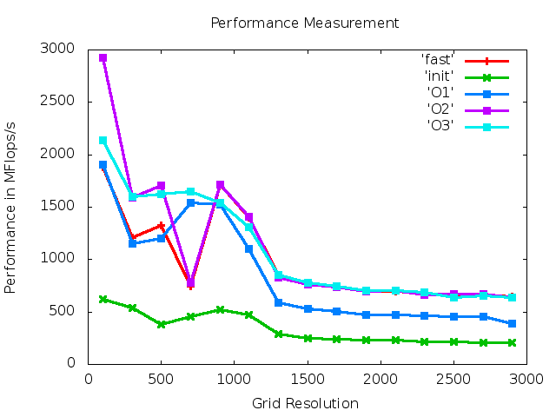
Comparison of results for various options

Slide 6
Peak Performance of Supermuc
1. Thereotical peak performance of one core on Supermuc is 21.6 Gflops
2. We got around 3 GFlops

Slide 7
Running code as batch job
Peak performance was lower in a batch job(2 GFlops) compared with login node(3 Gflops)

Slide 8
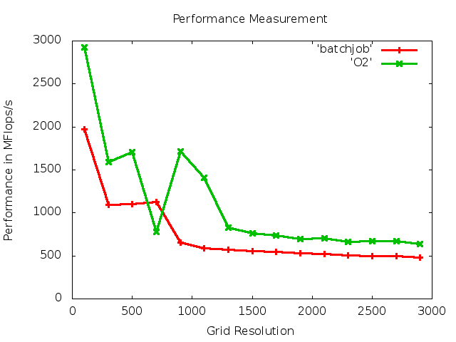

Slide 9
Gprof Utility
performance analyzing tool in Unix
Program can be compiled with -p -g to be used with gprof
After Run,gmon.out is generated
Can be viewed using gprof ./heat gmon.out

Slide 10
Runtime overhead of gprof
Program runtime as in gmon,out | Total program runtime with Profiling | Profiling overhead (sec)
41.78 | 43.386 | 1.606 ( 3.84 %)
41.97 | 43.564 | 1.594 ( 3.79 %)
41.83 | 43.386 | 1.556 ( 3.71 % )

Slide 11
Direct measurement of Performance Events
Library used to measure hardware performance counters – PAPI (Performance Application Programming Interface)
We used High level API's to calculate events for average CPI( Clocks per instruction ), flop rate and L3 cache hit rate

Slide 12
Average CPI
High level funtion used – PAPI_ipc( float * rtime, float * ptime, long_long * ins, float * ipc)
Upon first call of PAPI_ipc(), counters are set for PAPI_TOT_INS and PAPI_TOT_CYC
Upon second call, the counters are stopped & count for ipc is stored in float * ipc
CPI is multiplicative inverse of ipc

Slide 13
Flop rate
High level function – PAPI_flops() fails
We used counters with event PAPI_FP_OPS
Calculated Flop rate as #flops / program run time

Slide 14
L3 cache hit rate
Event PAPI_L3_TCH not supported with given hardware
Verified using the function PAPI_query_event()
Cache hits calculated as total cache accesses – total cache misses
Events used PAPI_L3_TCA & PAPI_L3_TCM respectively
L3 Cache hit rate = total L3 cache hits / program runtime

Slide 15
Optimization of Jacobi
Problem with np = 1022 – code thrashing
With np = 1022, grid size = 1024 (adding the boundary)
Issue can be solved with array padding

Slide 16
Different approaches for Jacobi Optimization
Access Pattern into Matrix
Calculation of residuum
Avoid Copy Operation
Cache Optimization by loop blocking
Cache Optimization by Interleaving of iterations

Slide 17
Access pattern into matrix
Matrix calculation & Copy operation in relax_jacobi() had flaws with memory access
Memory access not contiguous, stride of sizex
Problem solved by Loop Interchanging to make memory access contiguous, stride 1 access
Decreases cache misses

Slide 18
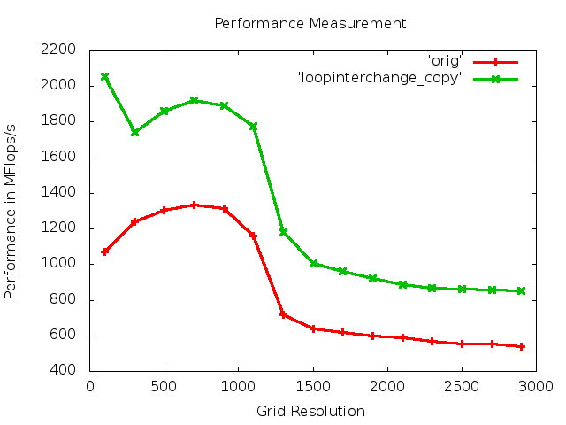
Access pattern into matrix (copy loop interchange)

Slide 19
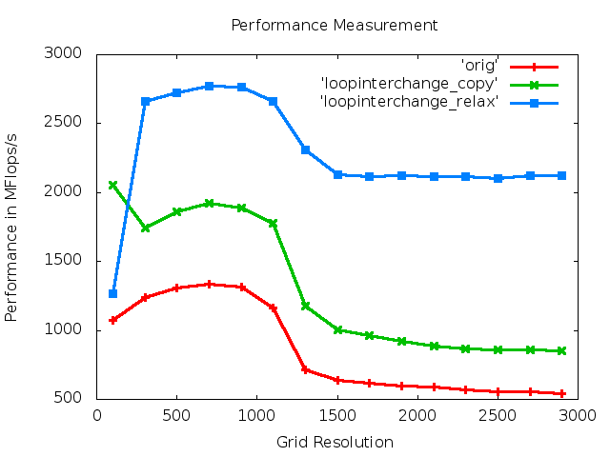
Access pattern into matrix (relaxation loop interchange)

Slide 20
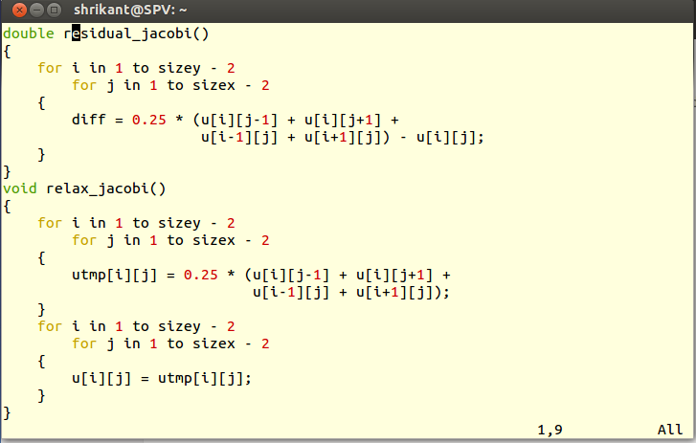
Calculation of residuum

Slide 21
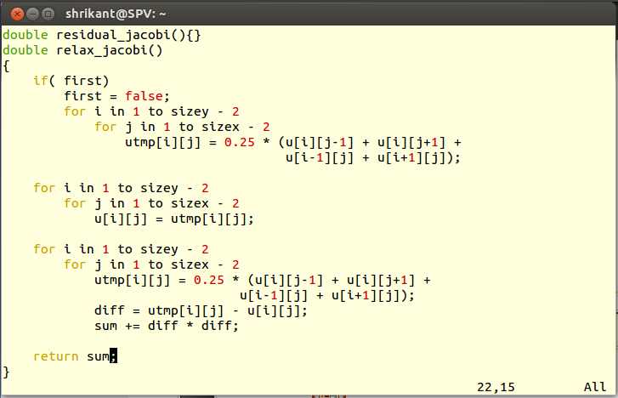
Changes in code

Slide 22
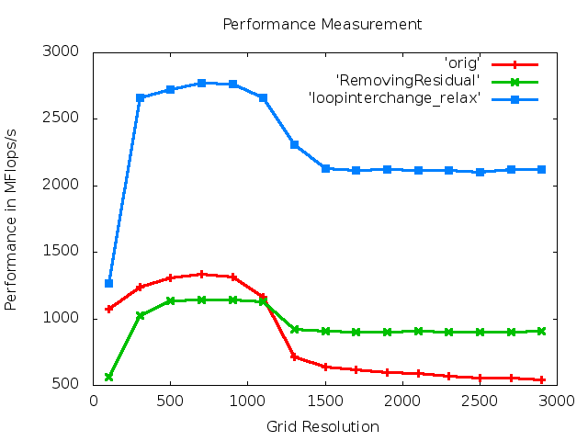
Modified residual calculation
Calculation results (in green)

Slide 23
Results after change in residual calculation
Although the performance in Mflops/s dropped, the no of floating point operations per loop changed from 11 to 4. Hence the total no of Gflops over an iteration as well as entire program dropped.
Advantage of this approach: the running time of program dropped from 14 sec to 11 sec (verified by repeating readings)

Slide 24
Initial loop blocking
Approach: horizontal splitting into 2 blocks & do 2 iterations in a single call of relax_jacobi

Slide 25
Horizontal Loop Blocking
Dividing the array into 4 horizontal blocks

Slide 26
Interleaving approach
1--> 3
0->2->4
1--> 3
0->2->4
1--> 3
0->2->4
1--> 3
0->2->4

Slide 27
Pattern looking for
1_1
2_1 1_2
3_1 2_2 1_3
4_1 3_2 2_3 1_4
4_2 3_3 2_4
4_3 3_4
4_4

